Slide 1
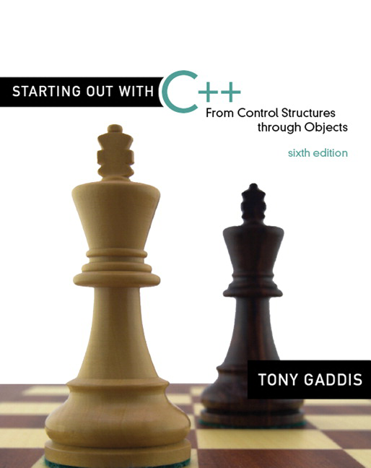

Chapter 9:
Pointers
Copyright © 2009 Pearson Education, Inc. Publishing as Pearson Addison-Wesley

Slide 2
9.1
Getting the Address of a Variable

Slide 3
Getting the Address of a Variable
Each variable in program is stored at a unique address
Use address operator & to get address of a variable:
  int num = -99;
  cout << &num; // prints address
  // in hexadecimal
9-<number>

Slide 4
9.2
Pointer Variables

Slide 5
Pointer Variables
Pointer variable : Often just called a pointer, it's a variable that holds an address
Because a pointer variable holds the address of another piece of data, it "points" to the data
9-<number>

Slide 6
Something Like Pointers: Arrays
We have already worked with something similar to pointers, when we learned to pass arrays as arguments to functions.
For example, suppose we use this statement to pass the array numbers to the showValues function:
showValues(numbers, SIZE);
9-<number>

Slide 7
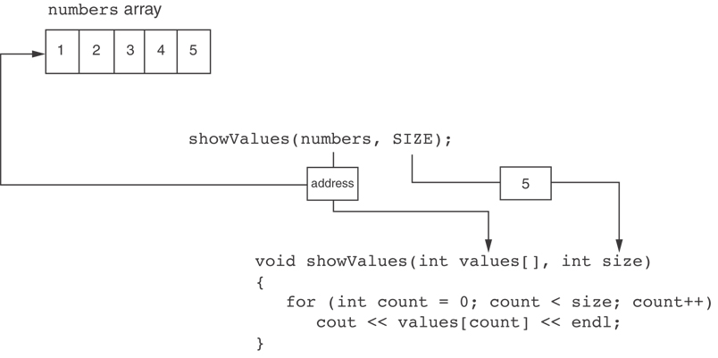
Something Like Pointers : Arrays
The values parameter, in the showValues function, points to the numbers array.
C++ automatically stores the address of numbers in the values parameter.
9-<number>

Slide 8
Something Like Pointers: Reference Variables
We have also worked with something like pointers when we learned to use reference variables. Suppose we have this function:
void getOrder(int &donuts)
{
cout << "How many doughnuts do you want? ";
cin >> donuts;
}
And we call it with this code:
int jellyDonuts;
getOrder(jellyDonuts);
9-<number>

Slide 9
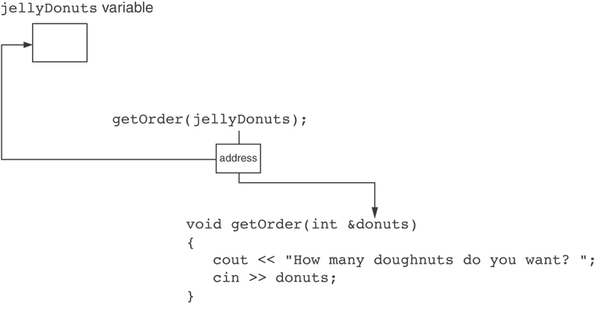
Something Like Pointers: Reference Variables
The donuts parameter, in the getOrder function, points to the jellyDonuts variable.
C++ automatically stores the address of jellyDonuts in the donuts parameter.
9-<number>

Slide 10
Pointer Variables
Pointer variables are yet another way using a memory address to work with a piece of data.
Pointers are more "low-level" than arrays and reference variables.
This means you are responsible for finding the address you want to store in the pointer and correctly using it.
9-<number>

Slide 11
Pointer Variables
Definition:
  int *intptr;
Read as:
“intptr can hold the address of an int”
Spacing in definition does not matter:
  int * intptr; // same as above
  int* intptr; // same as above
9-<number>

Slide 12
Pointer Variables
Assigning an address to a pointer variable:
  int *intptr;
  intptr = &num;
Memory layout:
num
intptr
25
0x4a00
address of num: 0x4a00
9-<number>

Slide 13
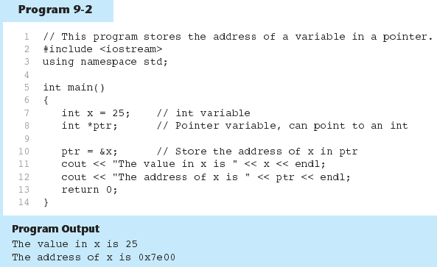
9-<number>

Slide 14
The Indirection Operator
The indirection operator (*) dereferences a pointer.
It allows you to access the item that the pointer points to.
int x = 25;
int *intptr = &x;
cout << *intptr << endl;
This prints 25.
9-<number>

Slide 15
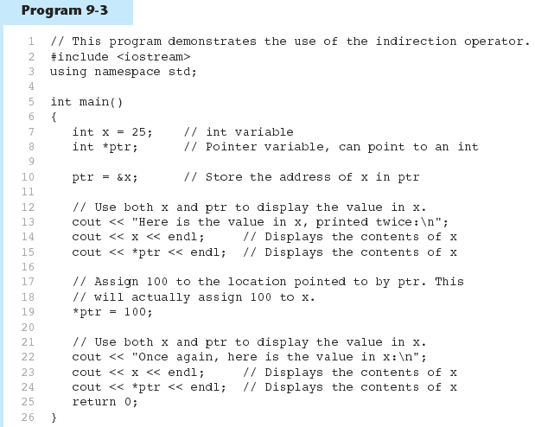
9-<number>

Slide 16
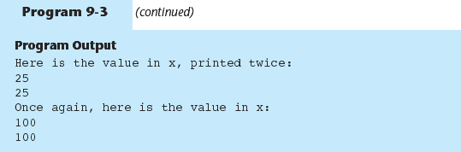
9-<number>

Slide 17
9.3
The Relationship Between Arrays and Pointers

Slide 18
The Relationship Between Arrays and Pointers
Array name is starting address of array
  int vals[] = {4, 7, 11};
  cout << vals; // displays
  // 0x4a00
  cout << vals[0]; // displays 4
4 | 7 | 11
starting address of vals: 0x4a00
9-<number>

Slide 19
The Relationship Between Arrays and Pointers
Array name can be used as a pointer constant:
  int vals[] = {4, 7, 11};
  cout << *vals; // displays 4
Pointer can be used as an array name:
  int *valptr = vals;
  cout << valptr[1]; // displays 7
9-<number>

Slide 20
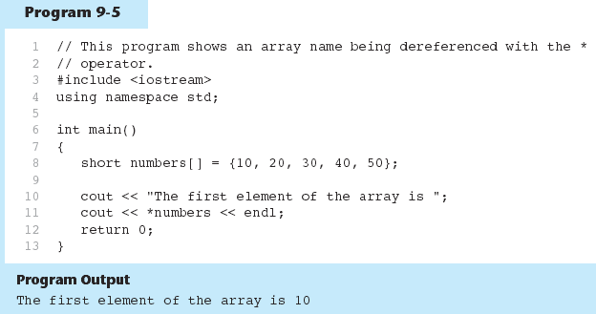
9-<number>

Slide 21
Pointers in Expressions
Given:
  int vals[]={4,7,11}, *valptr;
  valptr = vals;
What is valptr + 1? It means (address in valptr) + (1 * size of an int)
  cout << *(valptr+1); //displays 7
  cout << *(valptr+2); //displays 11
Must use ( ) as shown in the expressions
9-<number>

Slide 22
Array Access
Array elements can be accessed in many ways:
Array access method | Example
array name and [] | vals[2] = 17;
pointer to array and [] | valptr[2] = 17;
array name and subscript arithmetic | *(vals + 2) = 17;
pointer to array and subscript arithmetic | *(valptr + 2) = 17;
9-<number>

Slide 23
Array Access
Conversion: vals[i] is equivalent to *(vals + i)
No bounds checking performed on array access, whether using array name or a pointer
9-<number>

Slide 24
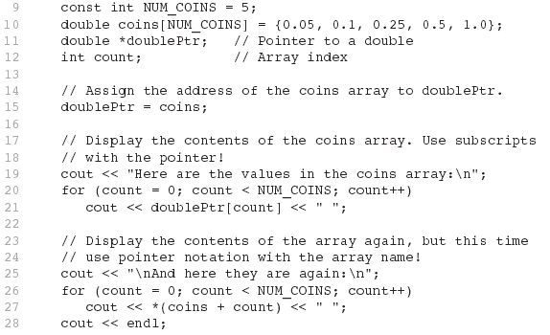

From Program 9-7
9-<number>

Slide 25
9.4
Pointer Arithmetic

Slide 26
Pointer Arithmetic
Operations on pointer variables:
Operation | Example int vals[]={4,7,11}; int *valptr = vals;
++, -- | valptr++; // points at 7 valptr--; // now points at 4
+, - (pointer and int) | cout << *(valptr + 2); // 11
+=, -= (pointer and int) | valptr = vals; // points at 4 valptr += 2; // points at 11
- (pointer from pointer) | cout << valptr–val; // difference //(number of ints) between valptr // and val
9-<number>

Slide 27
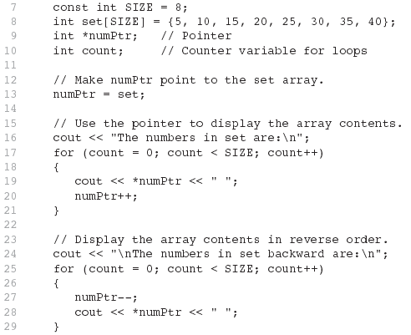

From Program 9-9
9-<number>

Slide 28
9.5
Initializing Pointers

Slide 29
Initializing Pointers
Can initialize at definition time:
  int num, *numptr = &num;
  int val[3], *valptr = val;
Cannot mix data types:
  double cost;
  int *ptr = &cost; // won’t work
Can test for an invalid address for ptr with:
  if (!ptr) ...
9-<number>

Slide 30
9.6
Comparing Pointers

Slide 31
Comparing Pointers
Relational operators (<, >=, etc.) can be used to compare addresses in pointers
Comparing addresses in pointers is not the same as comparing contents pointed at by pointers:
  if (ptr1 == ptr2) // compares
  // addresses
  if (*ptr1 == *ptr2) // compares
  // contents
9-<number>

Slide 32
9.7
Pointers as Function Parameters

Slide 33
Pointers as Function Parameters
A pointer can be a parameter
Works like reference variable to allow change to argument from within function
Requires:
  asterisk * on parameter in prototype and heading
  void getNum(int *ptr); // ptr is pointer to an int
  asterisk * in body to dereference the pointer
cin >> *ptr;
  address as argument to the function
  getNum(&num); // pass address of num to getNum
9-<number>

Slide 34
Example
void swap(int *x, int *y)
{ int temp;
temp = *x;
*x = *y;
*y = temp;
}
int num1 = 2, num2 = -3;
swap(&num1, &num2);
9-<number>

Slide 35
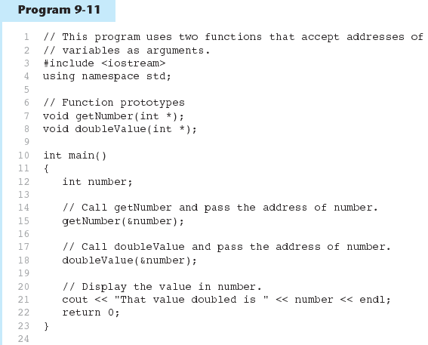
(Program Continues)
9-<number>

Slide 36
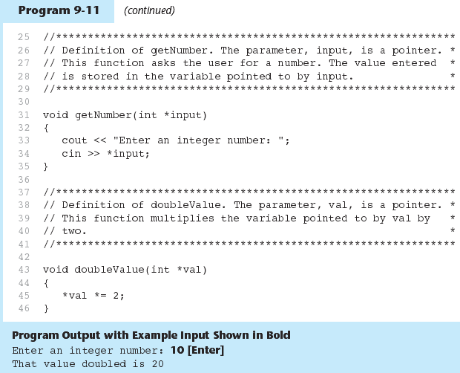
9-<number>

Slide 37
Pointers to Constants
If we want to store the address of a constant in a pointer, then we need to store it in a pointer-to-const.
9-<number>

Slide 38
Pointers to Constants
Example: Suppose we have the following definitions:
const int SIZE = 6;
const double payRates[SIZE] =
{ 18.55, 17.45, 12.85,
14.97, 10.35, 18.89 };
In this code, payRates is an array of constant doubles.
9-<number>

Slide 39
Pointers to Constants
Suppose we wish to pass the payRates array to a function? Here's an example of how we can do it.
void displayPayRates(const double *rates, int size)
{
for (int count = 0; count < size; count++)
{
cout << "Pay rate for employee " << (count + 1)
<< " is $" << *(rates + count) << endl;
}
}
The parameter, rates, is a pointer to const double.
9-<number>

Slide 40
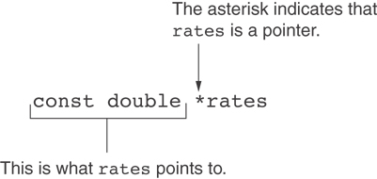
Declaration of a Pointer to Constant
9-<number>

Slide 41
Constant Pointers
A constant pointer is a pointer that is initialized with an address, and cannot point to anything else.
Example
int value = 22;
int * const ptr = &value;
9-<number>

Slide 42
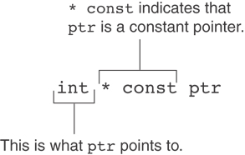
Constant Pointers
9-<number>

Slide 43
Constant Pointers to Constants
A constant pointer to a constant is:
  a pointer that points to a constant
  a pointer that cannot point to anything except what it is pointing to
Example:
int value = 22;
const int * const ptr = &value;
9-<number>

Slide 44
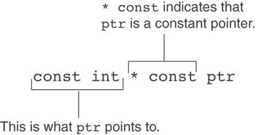
Constant Pointers to Constants
9-<number>

Slide 45
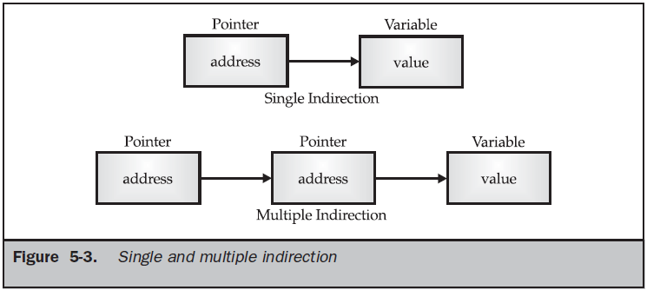
Pointer to Pointer
9-<number>

Slide 46
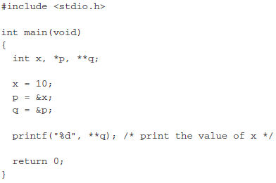
Pointer to Pointer
9-<number>

Slide 47
9.8
Dynamic Memory Allocation

Slide 48
Dynamic Memory Allocation
Can allocate storage for a variable while program is running
Computer returns address of newly allocated variable
Uses new operator to allocate memory:
  double *dptr;
  dptr = new double;
new returns address of memory location
9-<number>

Slide 49
Dynamic Memory Allocation
Can also use new to allocate array:
const int SIZE = 25;
arrayPtr = new double[SIZE];
Can then use [] or pointer arithmetic to access array:
  for(i = 0; i < SIZE; i++)
  *arrayptr[i] = i * i;
  or
  for(i = 0; i < SIZE; i++)
  *(arrayptr + i) = i * i;
Program will terminate if not enough memory available to allocate
9-<number>

Slide 50
Releasing Dynamic Memory
Use delete to free dynamic memory:
  delete fptr;
Use [] to free dynamic array:
  delete [] arrayptr;
Only use delete with dynamic memory!
9-<number>

Slide 51
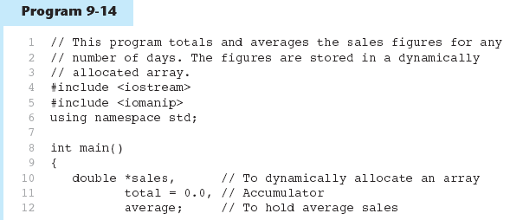
9-<number>

Slide 52
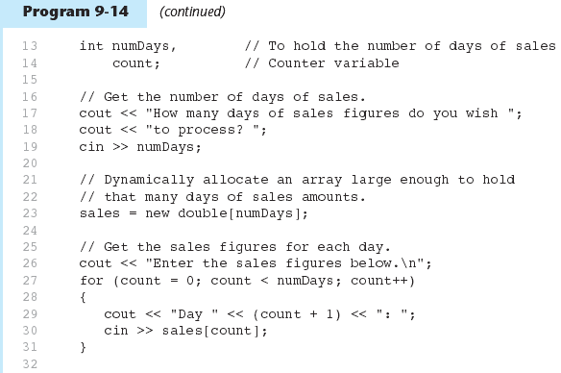
9-<number>

Slide 53
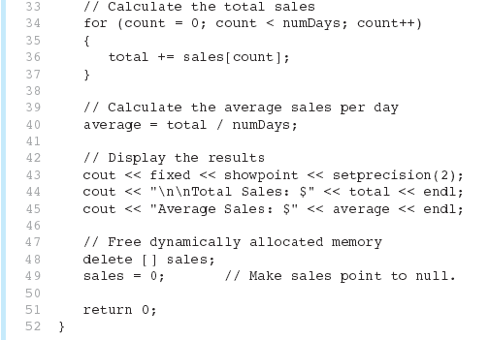
Program 9-14 (Continued)
9-<number>

Slide 54
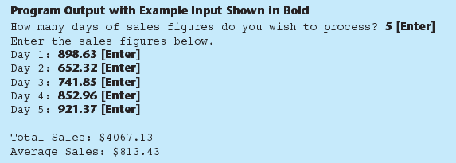
Notice that in line 49 the value 0 is assigned to the sales pointer. It is a good practice to store 0 in a pointer variable after using delete on it. First, it prevents code from inadvertently using the pointer to access the area of memory that was freed. Second, it prevents errors from occurring if delete is accidentally called on the pointer again. The delete operator is designed to have no effect when used on a null pointer.
9-<number>

Slide 55
9.9
Returning Pointers from Functions

Slide 56
Returning Pointers from Functions
Pointer can be the return type of a function:
  int* newNum();
The function must not return a pointer to a local variable in the function.
A function should only return a pointer:
  to data that was passed to the function as an argument, or
  to dynamically allocated memory
9-<number>

Slide 57
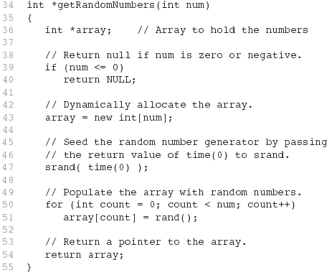
From Program 9-15
9-<number>

Slide 58
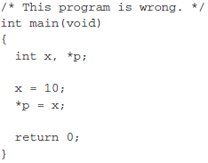
Problem with Pointers
Un-initialized pointer:
This program assigns 10 to some unknown memory location

Slide 59
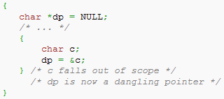
Problem with Pointers
Dangling pointer:
9-<number>

Slide 60
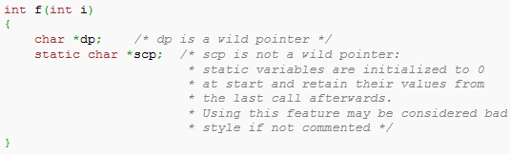
Problem with Pointers
Wild Pointer:
9-<number>

